Slide 1
Bootstrap
Front-End Web Development

Slide 2
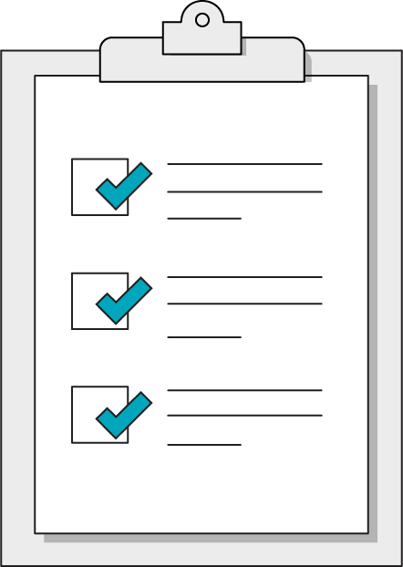
Today’s Learning Objectives
In this lesson, you will:
Use the Bootstrap CSS library to leverage pre-styled components.
Adapt Bootstrap components for specific use cases.
Evaluate CSS frameworks against self-written CSS.
‹#› | © 2020 General Assembly

Slide 3
CSS Frameworks
Front-End Web Development

Slide 4
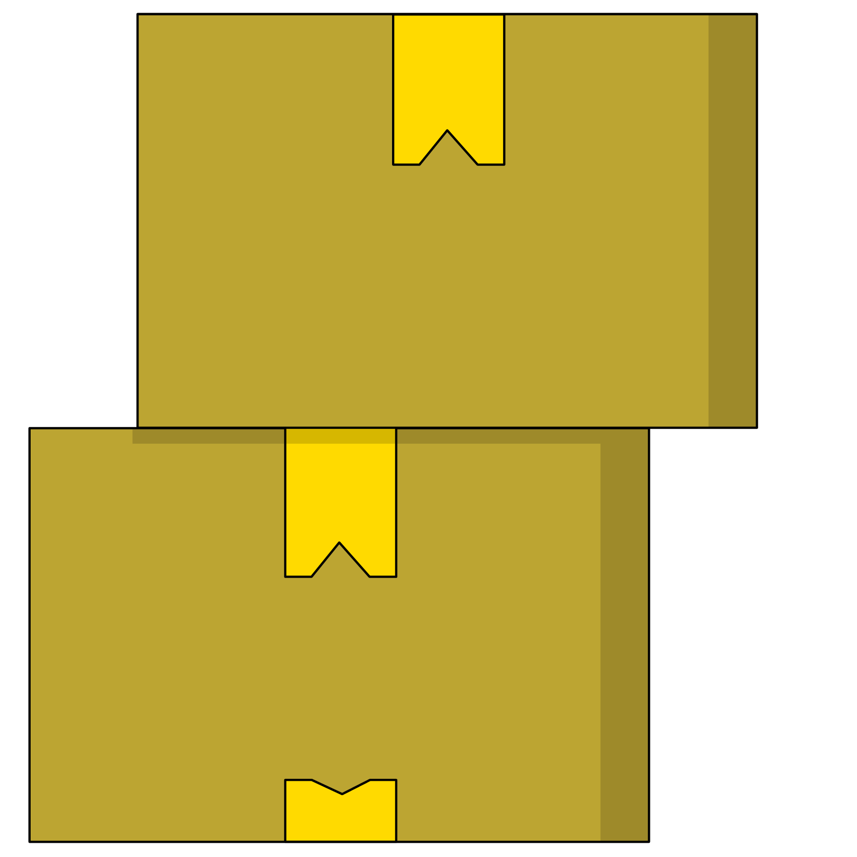
Frameworks
Frameworks are sets of pre-made HTML/CSS/JS components packaged together.
Think of a framework as a bunch of plugins made by the same team that so they work nicely together out of the box.

Slide 5

Should I Use a CSS Framework Like Bootstrap?
Benefits
Drawbacks
Gives you lots of code.
Grid-based design out of the box.
Easy integration of JS components.
Familiar, standard design feel.
Gives you lots of code.
Bloats your site with features you likely won’t use.
Design monotony.

Slide 6
Framework != Instant Boost
"Oh man, I'm getting all this code for free, so I don't have to spend as much time learning how to do things."
— Dangerous Developer Thoughts, Volume XVII
Frameworks will slow you down until you learn how to use them.
When you choose to use a framework, you’re embracing patterns created by other developers. It takes time to learn these patterns.

Slide 7

Common Frameworks
Bootstrap: http://getbootstrap.com/
Foundation: http://foundation.zurb.com/
Material Design Lite: https://getmdl.io/

Slide 8
Using Bootstrap
Front-End Web Development

Slide 9

Bootstrap
The most popular framework.
Standard-feeling style
Responsive grid system.
Easy, built-in breakpoints
Plug-and-play components.
Navbars, modals, carousels...

Slide 10
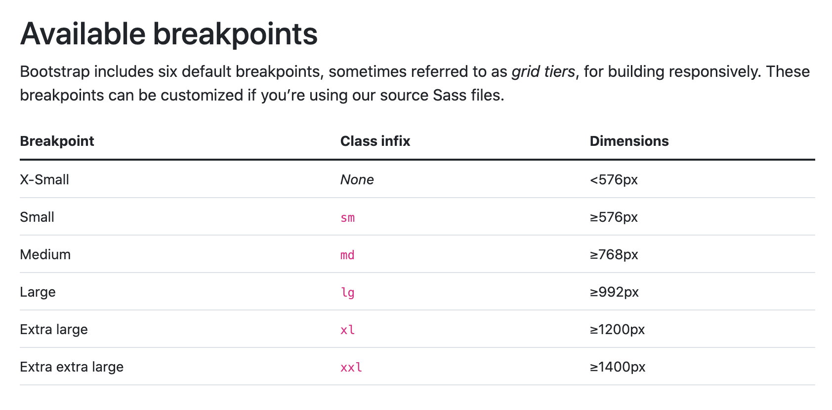

Slide 11
Grid-Based Design
Bootstrap sets up a series of 12 columns that automatically respond to screen size.
1
2
3
4
5
6
7
8
9
10
11
12

Slide 12
Bootstrap Grid
Each time you use the “row” class on a container, that container is divided into 12 default columns
You can then create child containers that “clip” into the grid and take up 1–12 columns.
1
2
3
4
5
6
7
8
9
10
11
12

Slide 13
Bootstrap Grid
All content should be placed within grid columns. Build column classes using the following formula:
col-{screen-size}-{width}
Examples of Bootstrap column classes:
<div class="col-md-6"> | A div for medium-sized screens that is 6 columns wide.
<div class="col-lg-2"> | A div for large screens that is 2 columns wide.
1
2
3
4
5
6
7
8
9
10
11
12

Slide 14
Bootstrap Grid
The grid structure is very similar to patterns in flexbox and grid:
<div class="container"> | Top-level element; holds rows
<div class="row"> | Horizontal row holds col elements. Must be the immediate child of a container.
<div class="col"> | Used to hold content & components (text/images/etc.). Must be the immediate child of a row.

Slide 15
Bootstrap Rules of the Grid
Columns must be placed into an element with the row class to create horizontal groups.
The total column width classes in a row must add up to 12.
If you don’t define specific numbers “col-md-4”, Bootstrap will divide the space equally among the number of columns
rows must be placed within a parent with the class of:
.container (fixed-width with side margins all screens) or
.container-fluid (full-width on all screens)

Slide 16
All Together Now!
This is how you Bootstrap:
<div class="container">
<div class="row">
<div class="col-6">
Your content here.
</div>
<div class="col-6">
Your content here.
</div>
</div>
</div>
1
2
3
4
5
6
7
8
9
10
11
12

Slide 17
How Would We Make This Layout?
1
2
3
4
5
6
7
8
9
10
11
12

Slide 18
Grid Layouts
45 minutes
Recreate the grid layouts displayed in this document:
https://ga-instruction.s3.amazonaws.com/assets/front-end-web-development/fewd-bootstrap/layouts.pdf

Slide 19
Bootstrap Components
Front-End Web Development

Slide 20

Components Made Easy
Bootstrap has a solid set of standard components that can easily be dropped into your site:
Navigation bars
Modals
Image carousels
Dropdown menus
And so much more!

Slide 21
Bootstrap Nav
You’ve definitely seen the Bootstrap navbar before!
<nav class="navbar navbar-default" role="navigation">
<div class="container">
...
</div>
</nav>

Slide 22
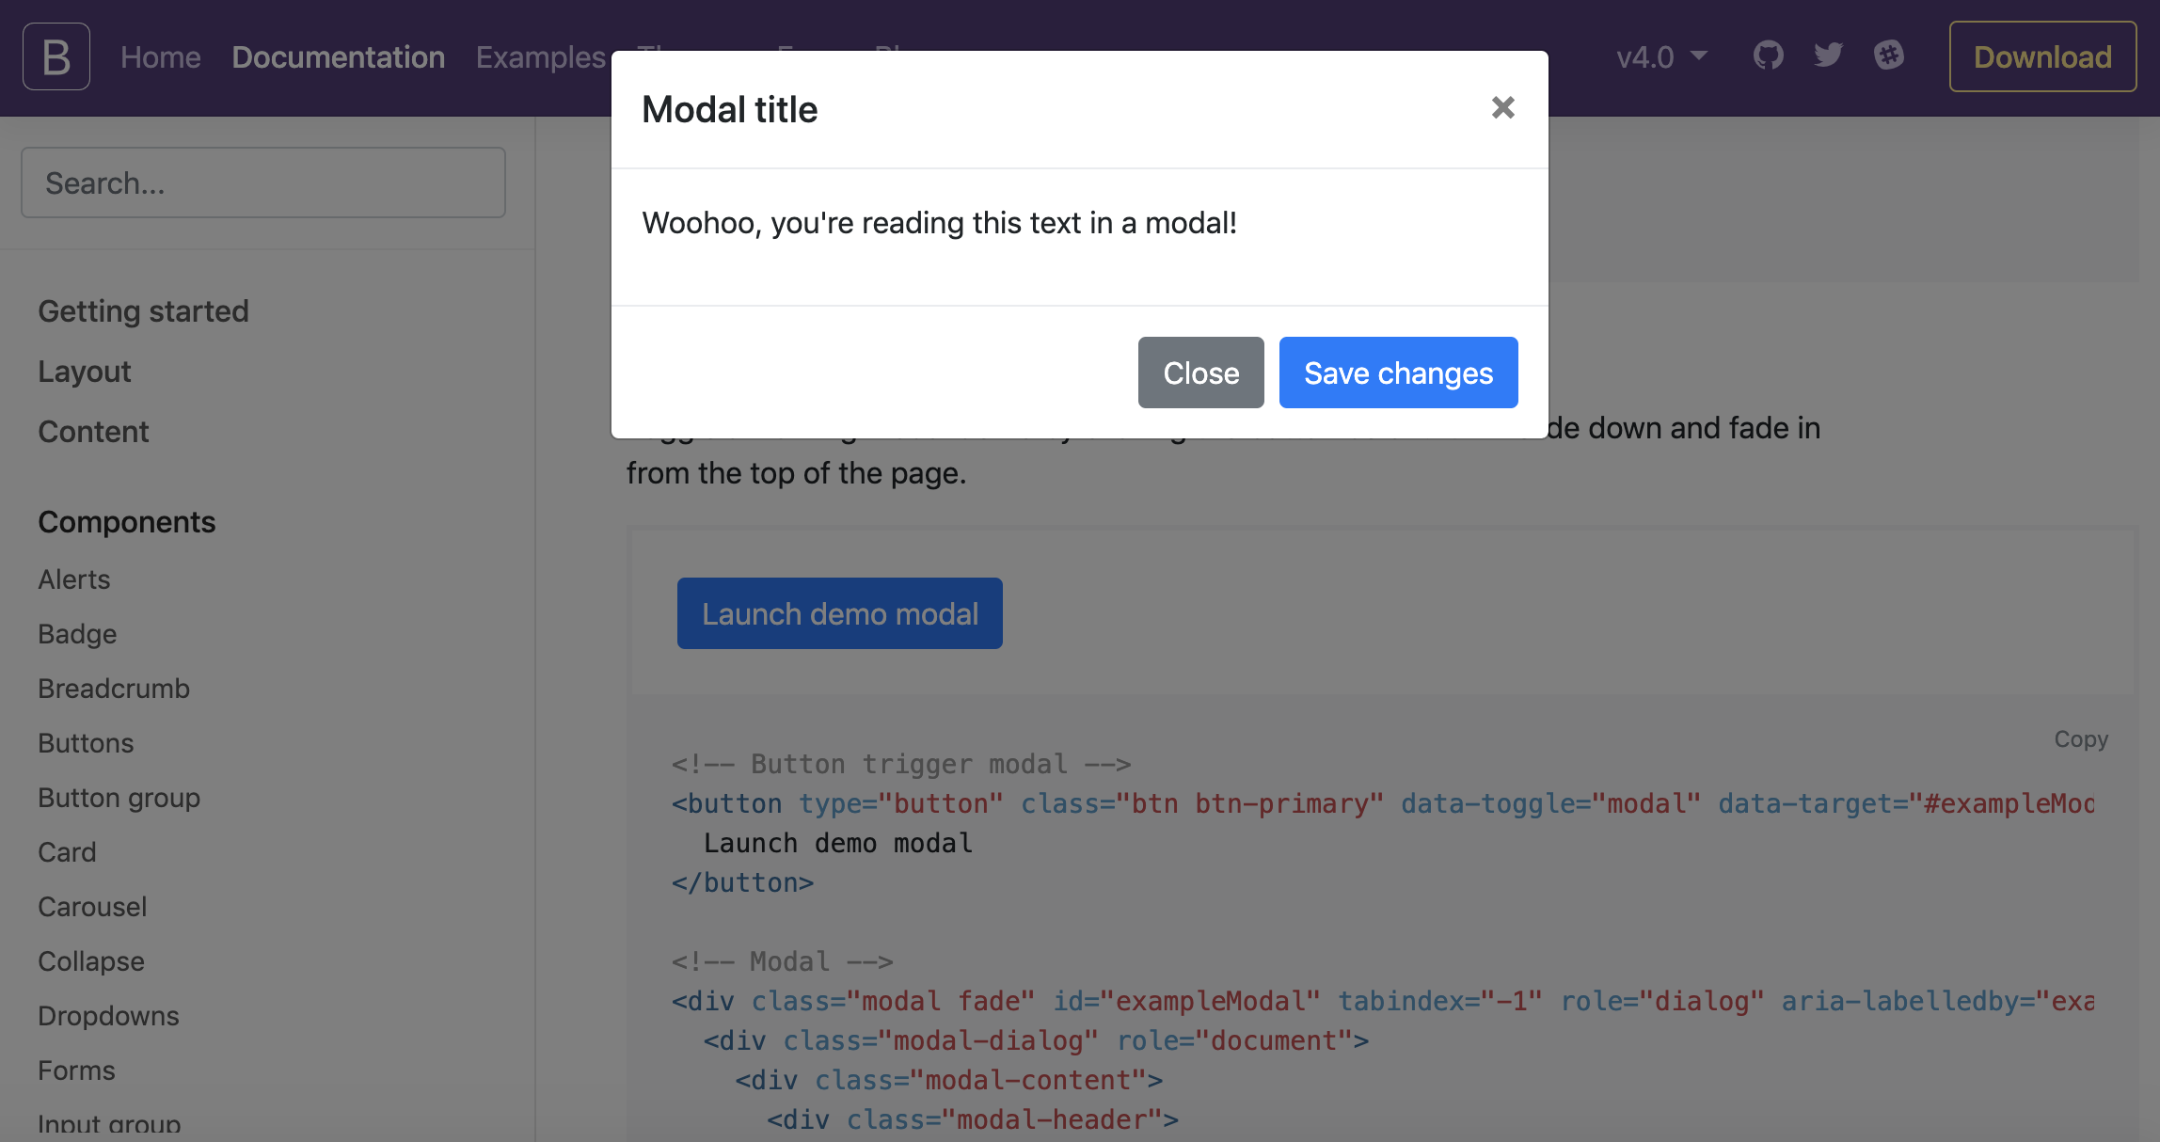
Modals: Pop Ups for Good, not Spam!
Modals allow content to be focused in a pop-up window on top of other content.
They can be toggled with JavaScript in reaction to any event, typically responding to button clicks.

Slide 23
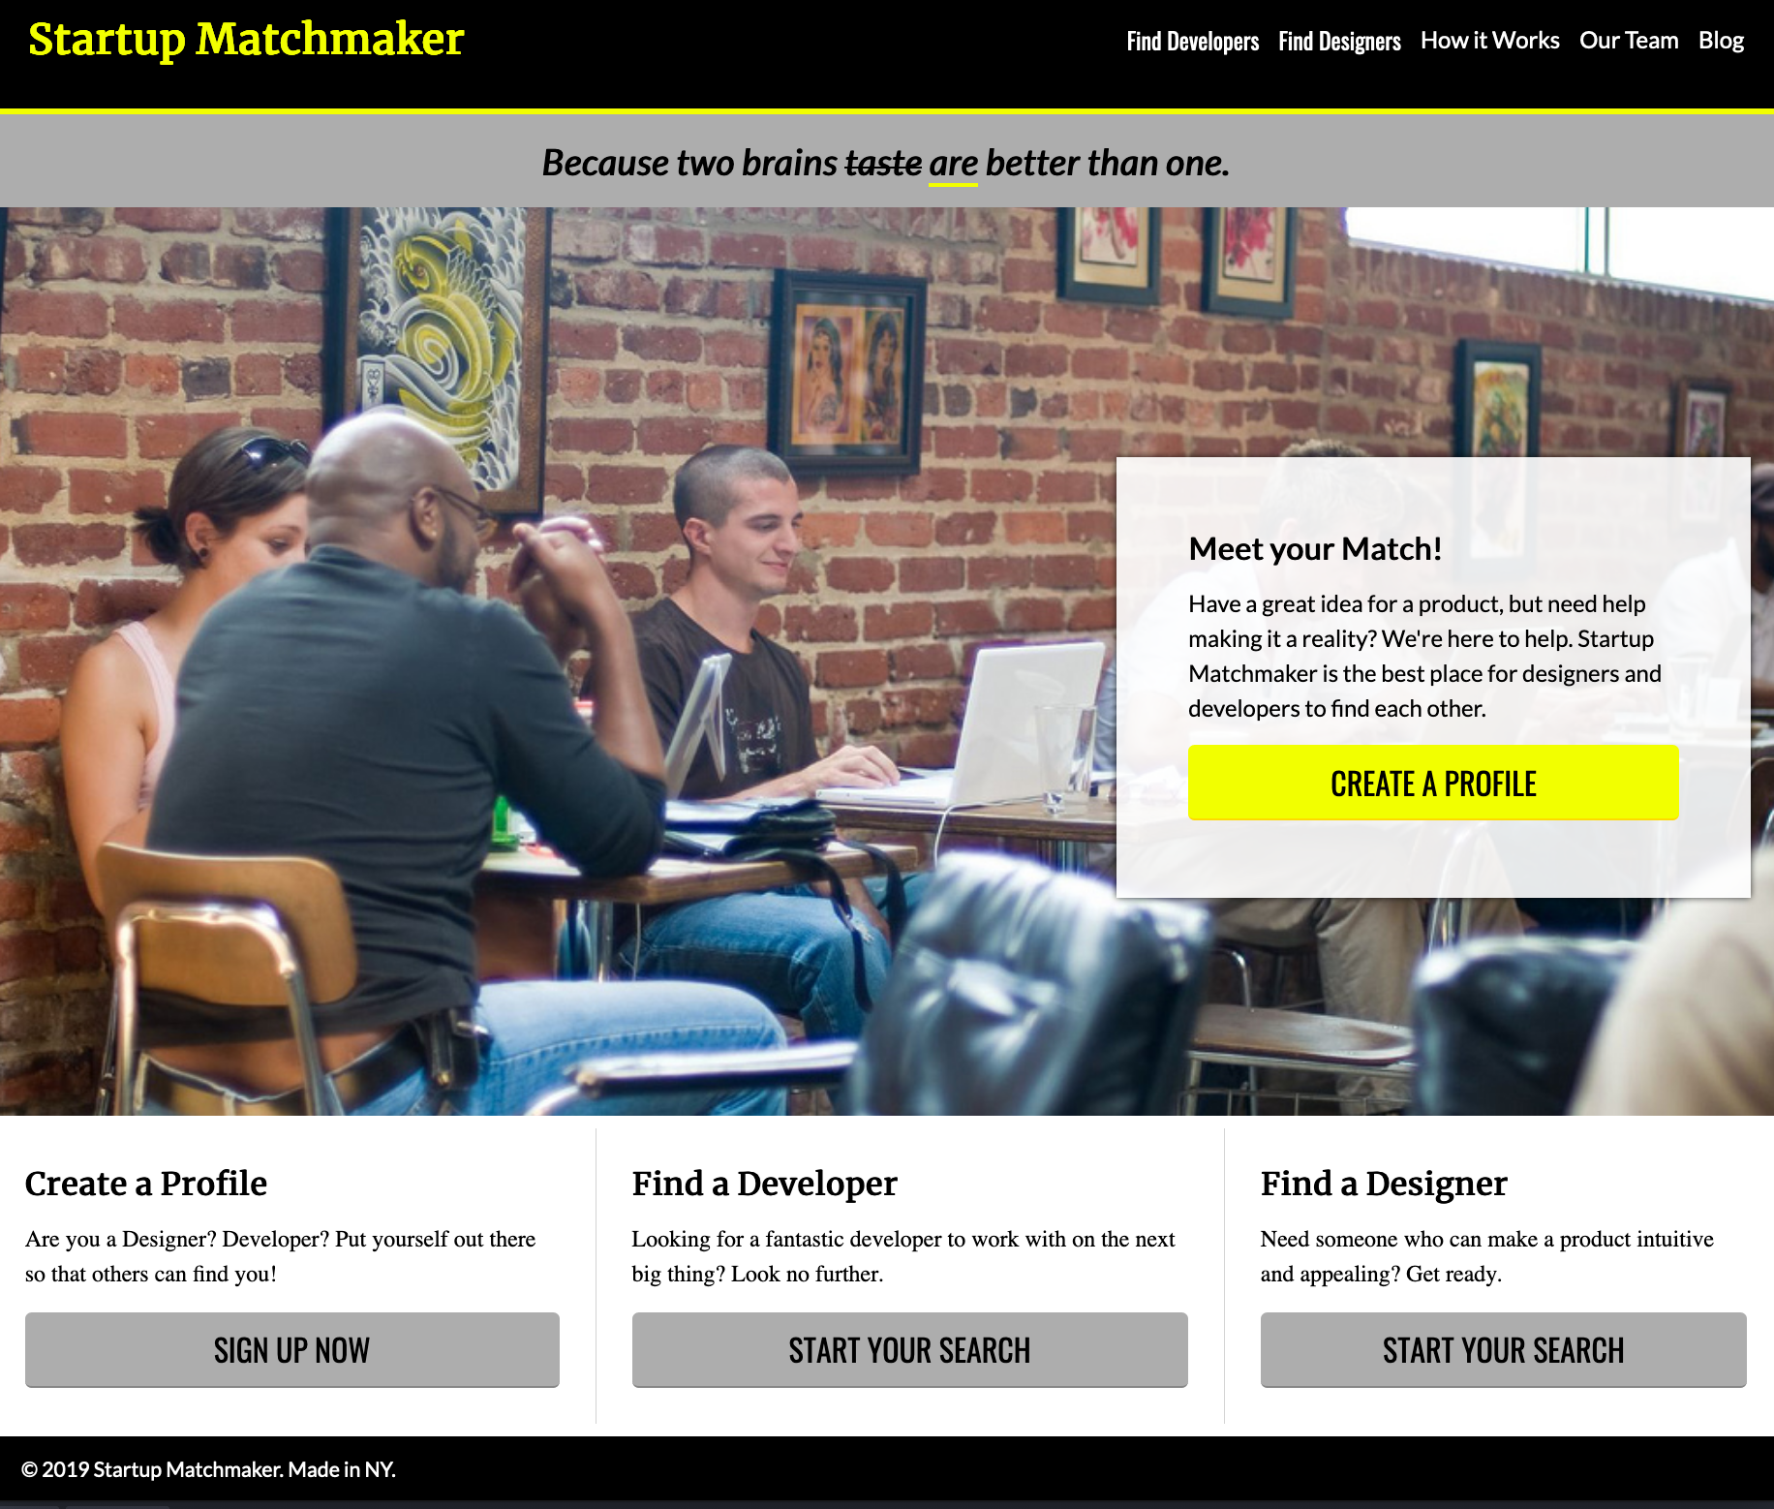
StartUp Matchmaker Bootstrapped
Reference code:
https://drive.google.com/drive/folders/1nGs9ISklpozgATRGRPEQ3e1qeldbVk35?usp=sharing
Spice up an old favorite with a new layout treatment.

Slide 24
Styles
Front-End Web Development
(Without the Pain and Suffering of Tweaking It Yourself)

Slide 25
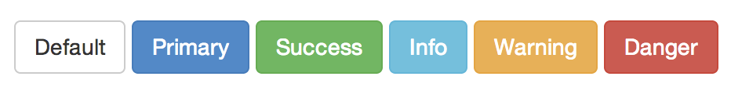
Buttons
http://getbootstrap.com/css/#buttons
<!-- Standard button --> <button type="button" class="btn btn-default">Default</button>
We can change button color and size very easily. Follow that link to see how.

Slide 26

Responsive Images
Creating responsive images is as easy as adding this class to your image: .img-responsive
This class gives us the following code: max-width: 100%; height: auto;

Slide 27
Stylized Images
Check out these puppies:
<img src="puppy.jpg" class="img-rounded" alt="Rounded Puppy">
<img src="puppy.jpg" class="img-circle" alt="Circle Puppy">
<img src="puppy.jpg" class="img-thumbnail" alt="Puppy Thumbnail">
img-rounded creates rounded rectangles.
img-circle turns images into circles.
img-thumbnail puts a nice border around images.

Slide 28

Recreate a Bootstrap Site
Identify a site using Bootstrap and attempt to recreate it. There are many resources that list sites that use Bootstrap, or you can check your favorite sites for Bootstrap-style layouts and components.
https://expo.getbootstrap.com/

Slide 29
Key Takeaways
For Next Time
CSS Frameworks Are a Trade-Off
Developer Tools
You get pre-built style and components in exchange for learning and using their exact patterns.
Frameworks can add unnecessary bloat to a site.
The command line provides a direct interface with more powerful control over your computer.
Git and GitHub are industry-standard tools for version control.
‹#› | © 2020 General Assembly

